Slide 1



KNN Classifier Accelerator
Frontend Design Review
Students: Roy Rapaport, Dan Katz
Supervisor: Goel Samuel

Slide 2
Outline
KNN Algorithm
Project’s requirements and specifications
Progress review: Stages covered
Frontend design plan
Simulation tests
Milestones ahead

Slide 3
KNN Algorithm- Introduction
Definition: The K-nearest neighbors (KNN) is a non-parametric, supervised algorithm used for classification and regression tasks.
Core Idea: KNN uses proximity to make classification or predictions about the grouping of an individual data point.

Slide 4
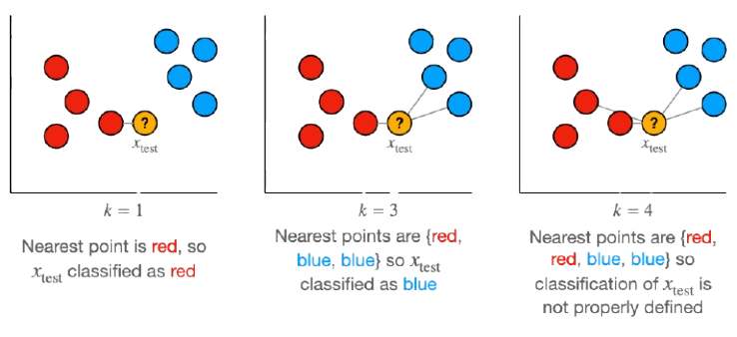
KNN Algorithm- Example
The example was taken from: https://towardsdatascience.com/

Slide 5
KNN Algorithm- Example
The example was taken from: https://towardsdatascience.com/

Slide 6
KNN Algorithm- Example
The example was taken from: https://towardsdatascience.com/

Slide 7
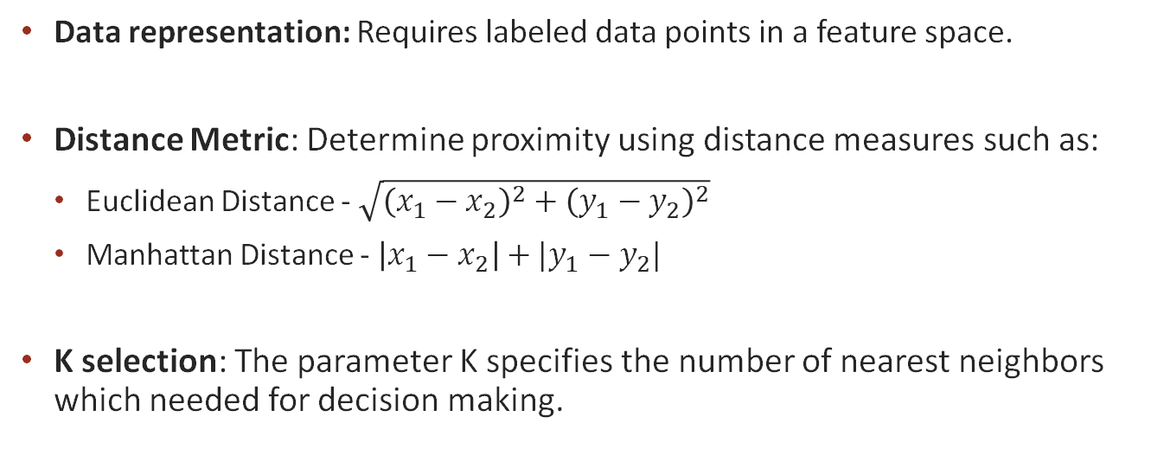
KNN Algorithm- How it works?
Data representation: Requires labeled data points in a feature space.
Distance Metric: Determine proximity using distance measures such as:
  Euclidean Distance - $\sqrt{{\left(x_{1}−x_{2}\right)}^{2}+{\left(y_{1}−y_{2}\right)}^{2}}$
  Manhattan Distance - $\left|x_{1}−x_{2}\right|+|y_{1}−y_{2}|$
K selection: The parameter K specifies the number of nearest neighbors which needed for decision making.

Slide 8
KNN Algorithm- Steps
Data preparation: Store all training data in memory.
In certain cases, we normalize or scale the training data to avoid biases from differing feature magnitudes.
Compute distance: For each new test point, calculate the distance to all training points.
Neighbor selection: Identify the K closest training points based on the chosen distance metric.
Predict output:
  Classification: assign the class based on majority.
  Regression: assign the average value of the K-nearest neighbors.

Slide 9
Project’s Requirements and Specifications
KNN Algorithm:
  K: 5
  Number of groups: 2
  Distance Metric: Manhattan Distance
  Number of Train points: 128
  Data points range: [0,1023]

Slide 10
Project’s Requirements and Specifications
Technology process: TSMC 65 nm
Maximum area: 1.0x1.0 sq mm
Maximum number of I/Os: 48
Clock frequency: 100 Mhz
Performance efficiency

Slide 11
Progress Review: Stages Covered

Slide 12
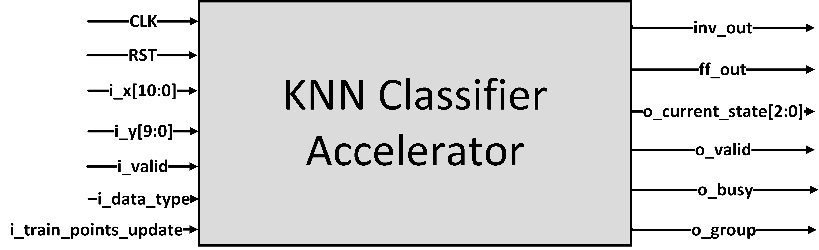
I/O Diagram
26 Inputs pins, 8 Outputs pins
i_x Data Packet
Group
X Value
0 | 1 | 0 | 1 | 1 | 0 | 1 | 1 | 0 | 0 | 1

Slide 13
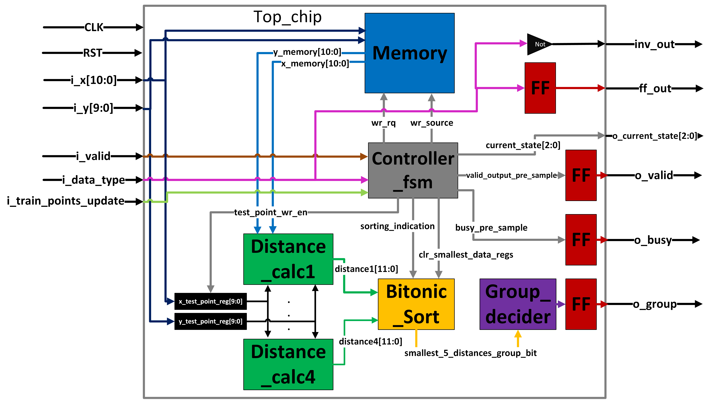
Top Level Architecture

Slide 14
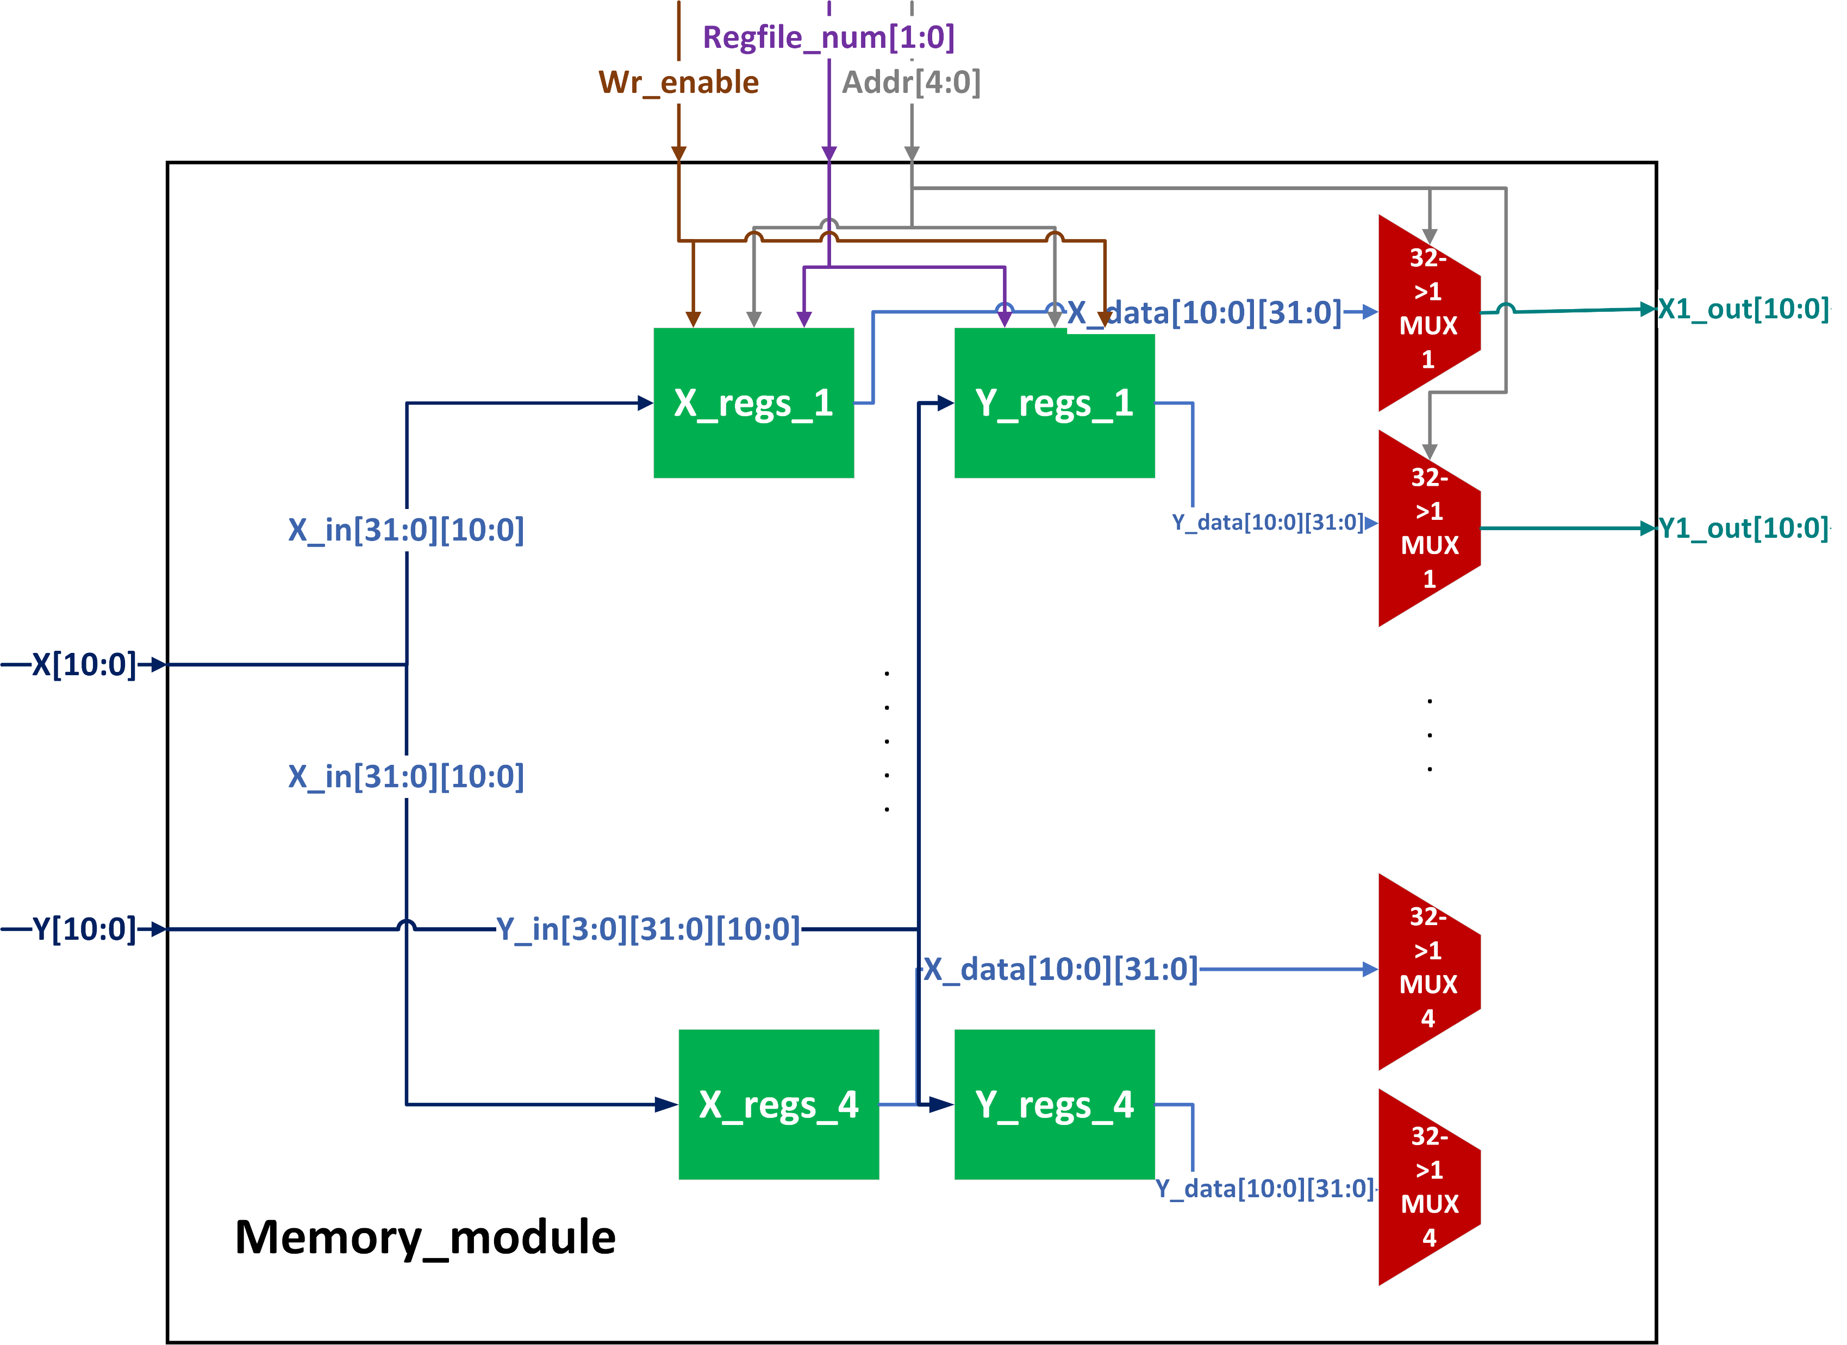
Memory – option 1

Slide 15
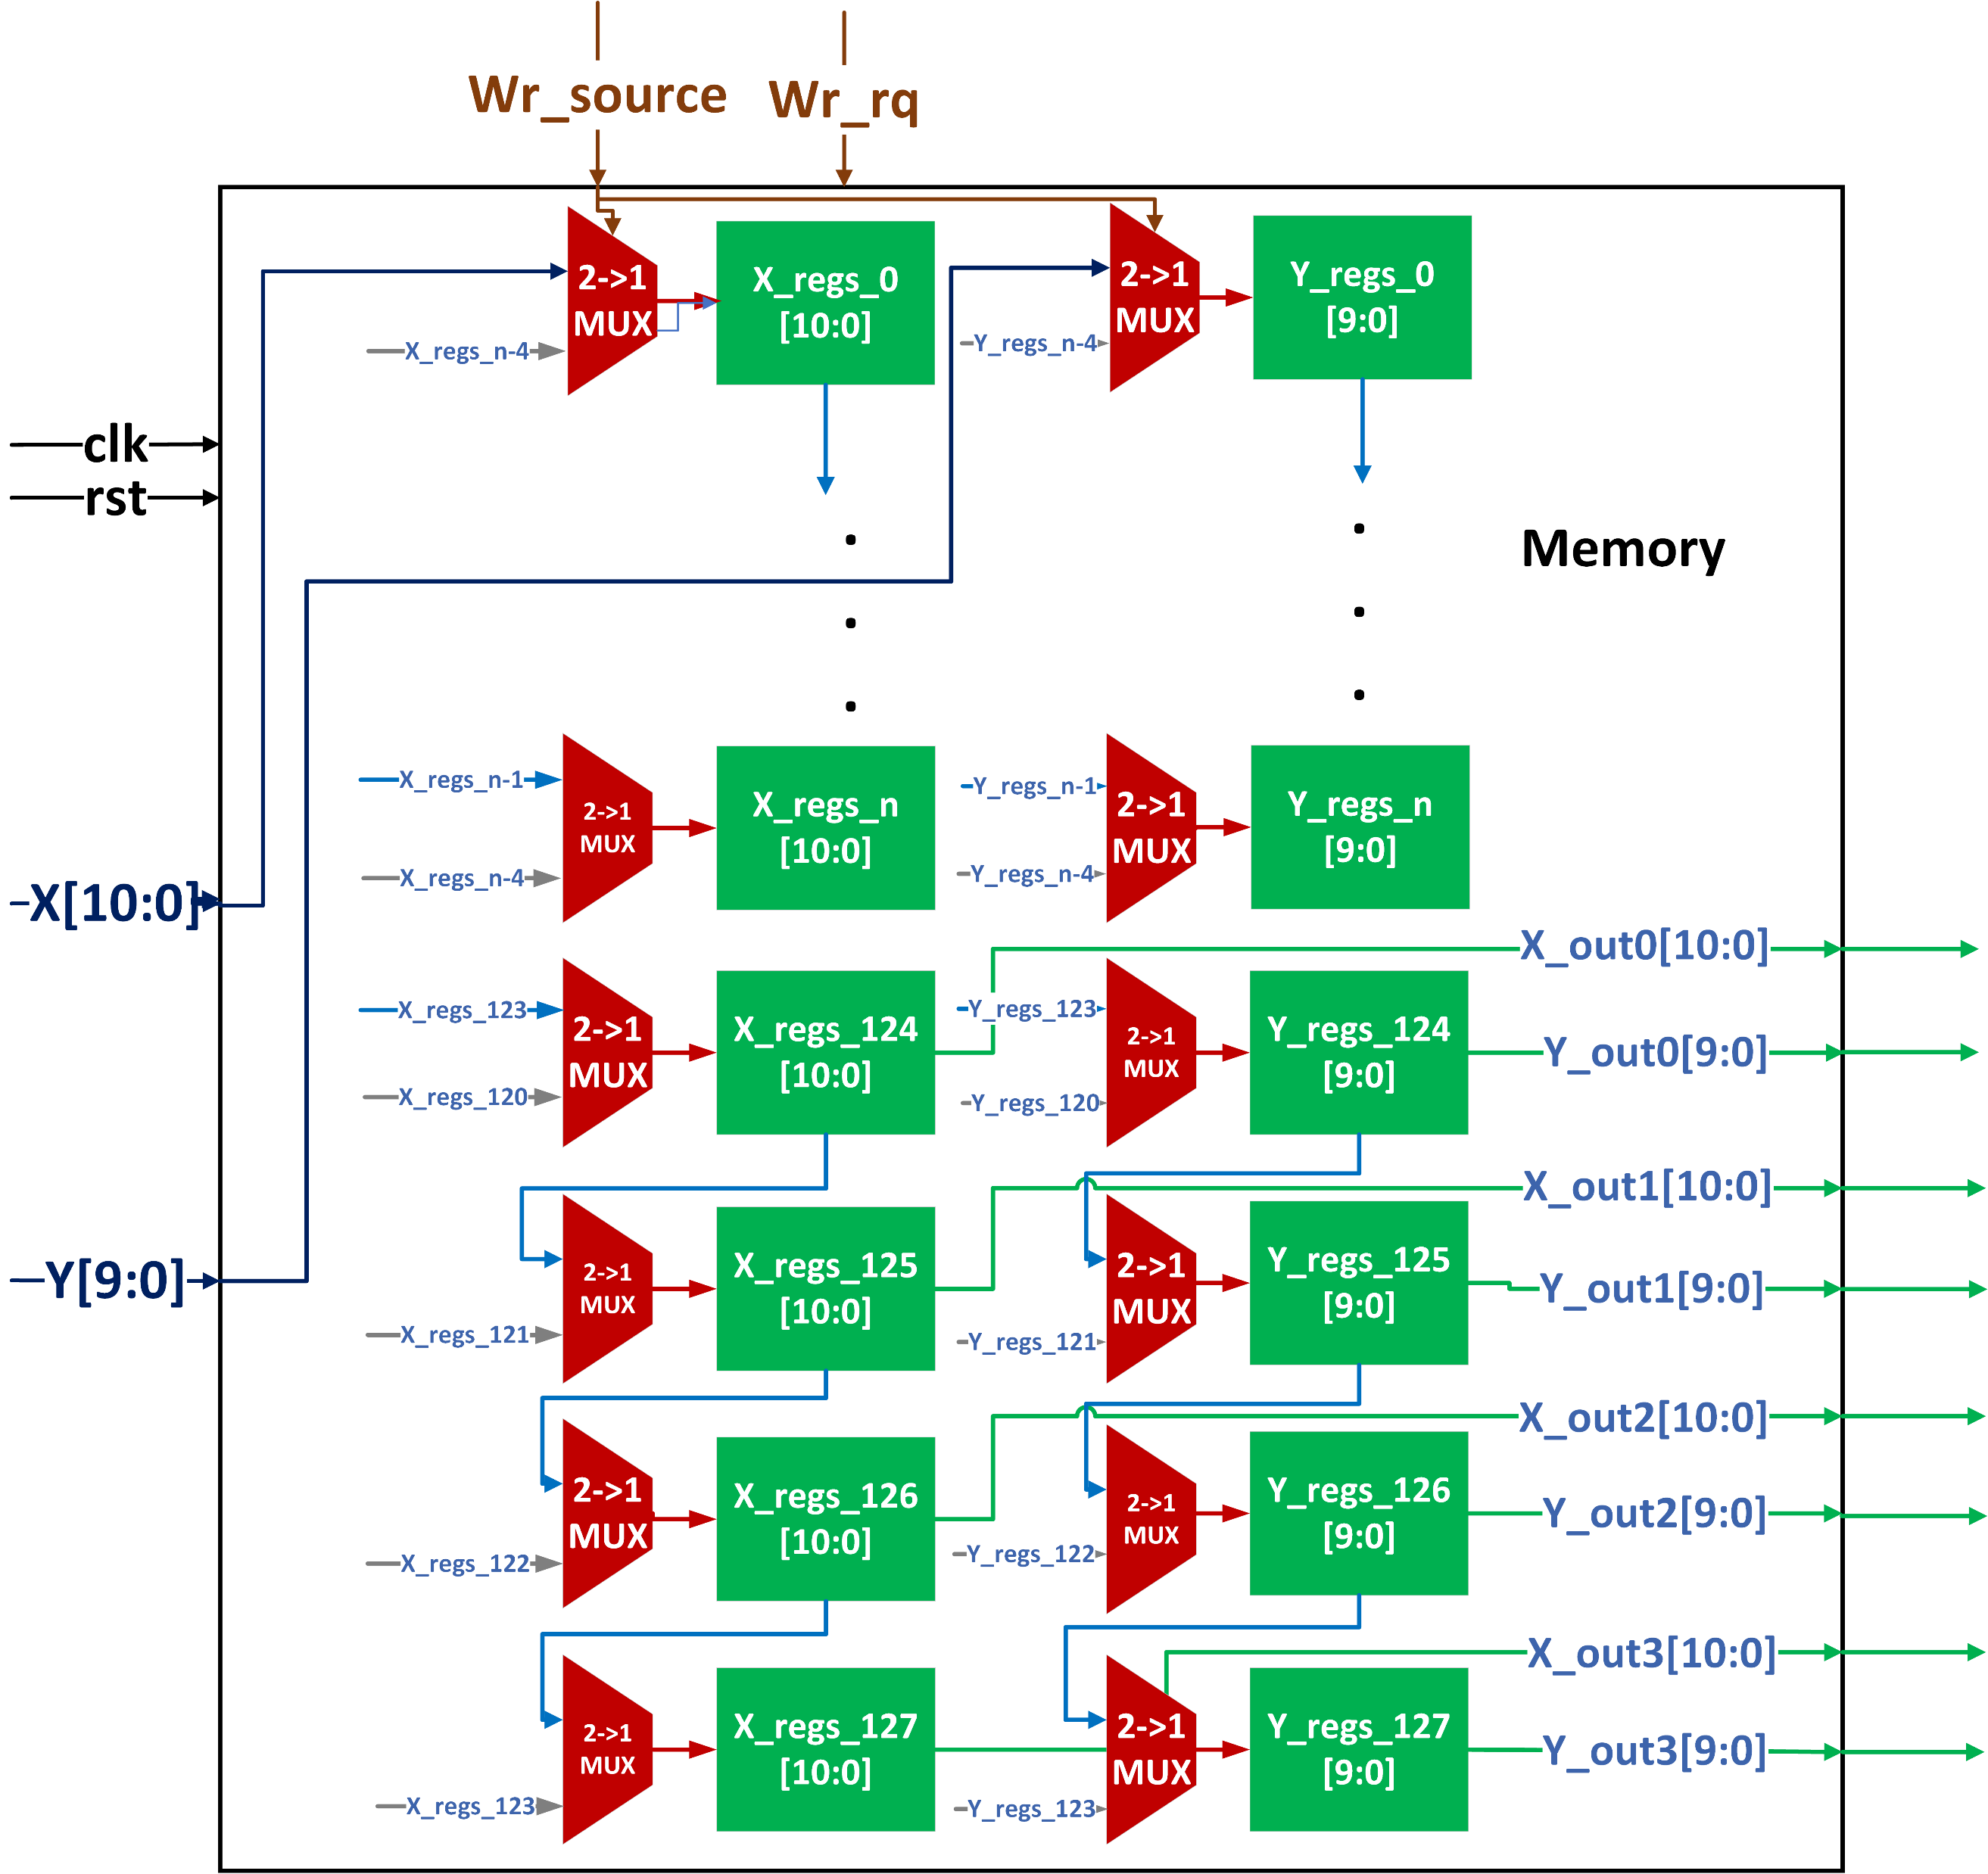
Memory – option 2

Slide 16
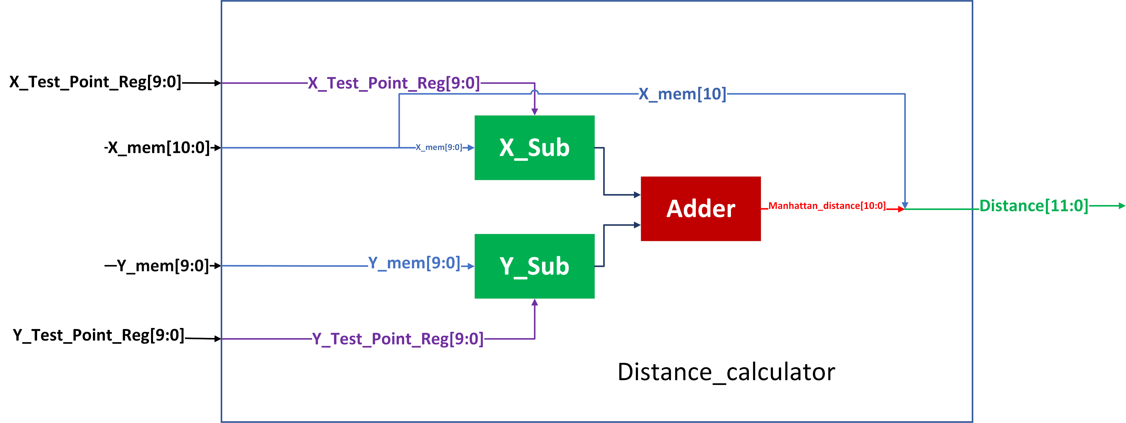
Distance calculator

Slide 17
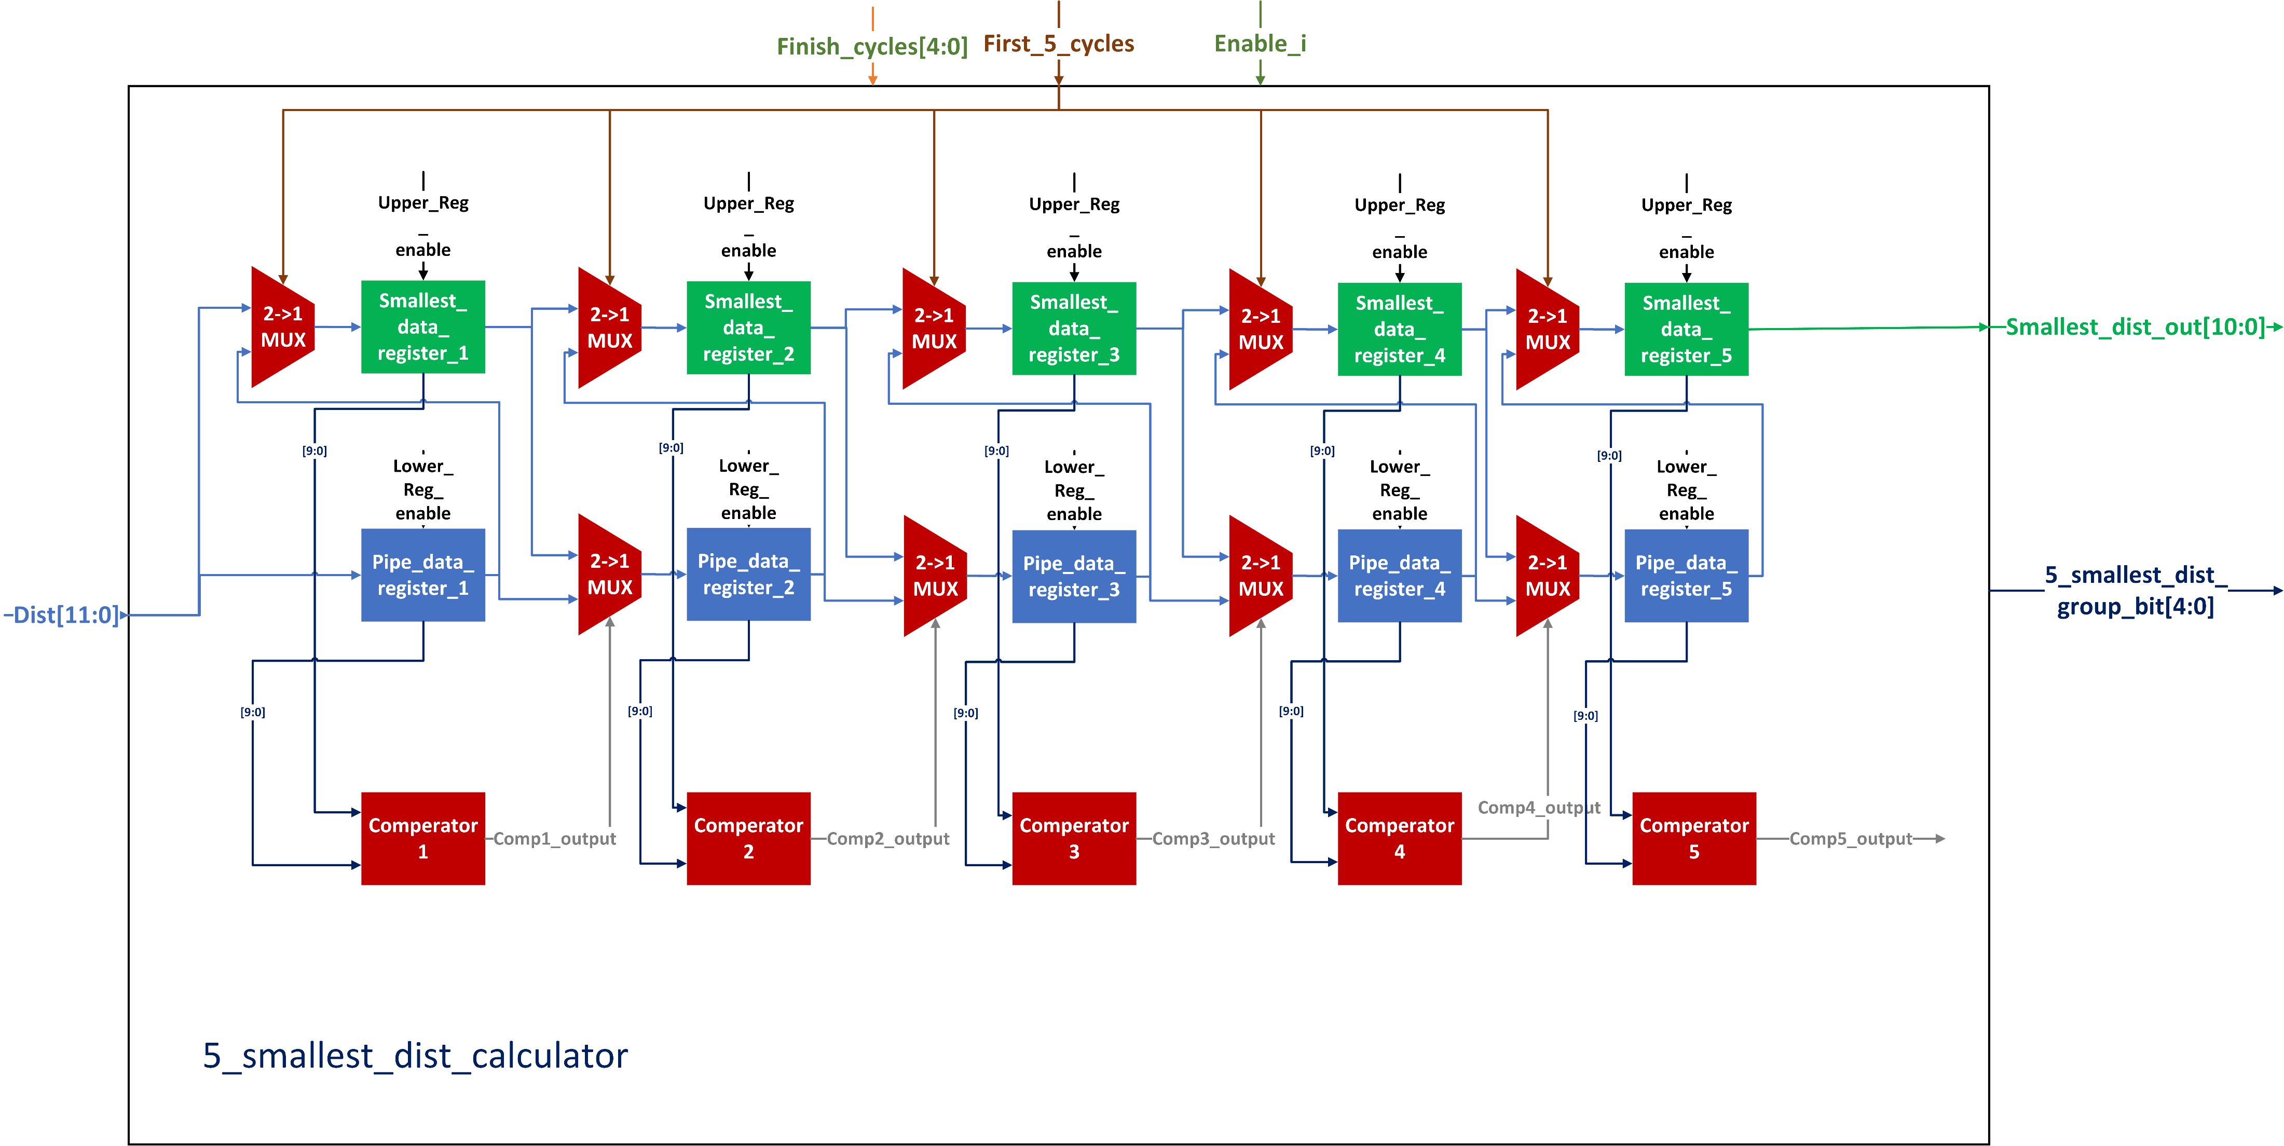
Sort – option 1

Slide 18
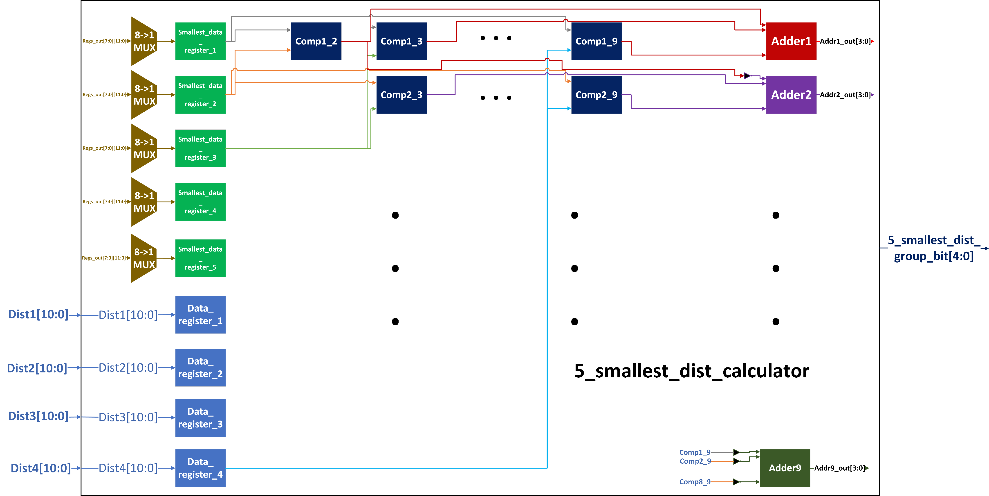
Sort – option 2

Slide 19
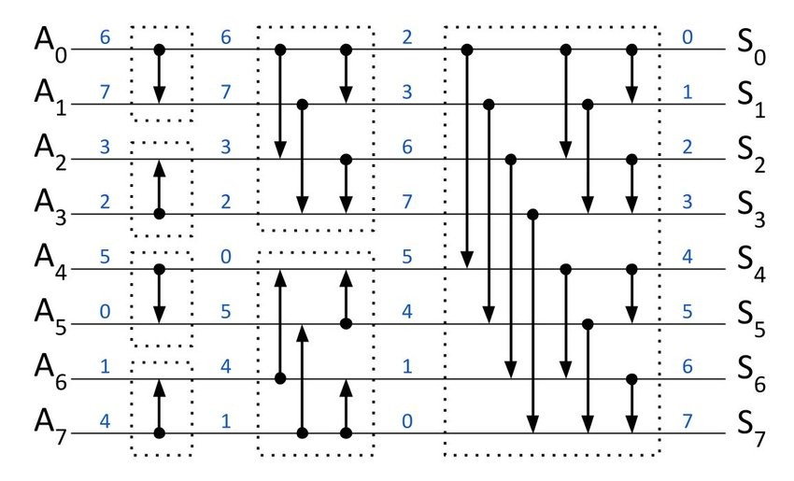
Bitonic Sort – example

Slide 20
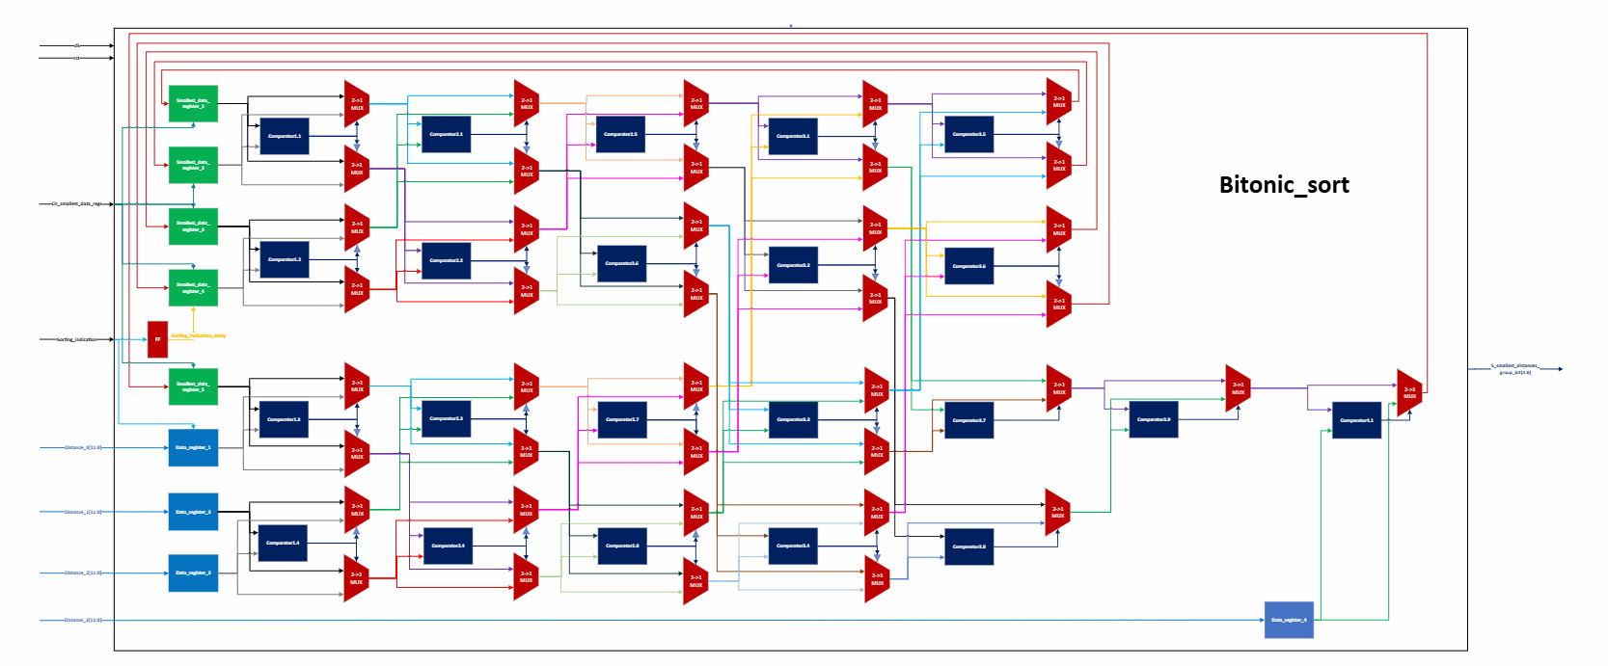
Bitonic Sort

Slide 21
Bitonic Sort – phase 1
Phase 1

Slide 22
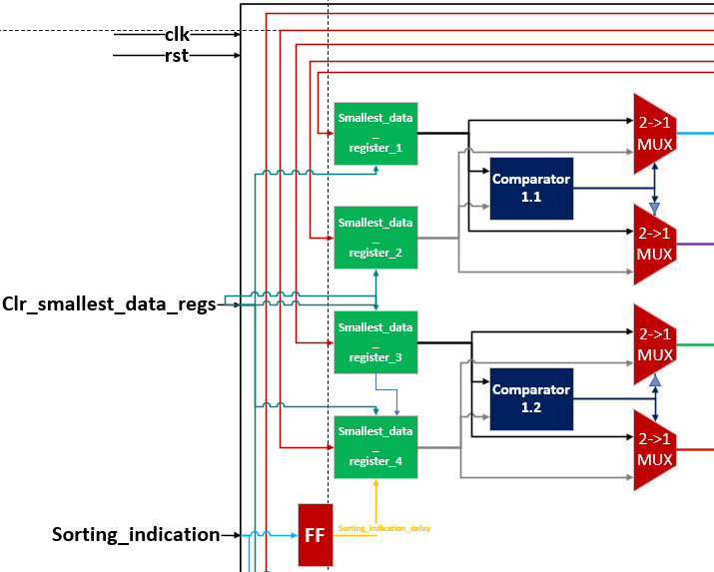
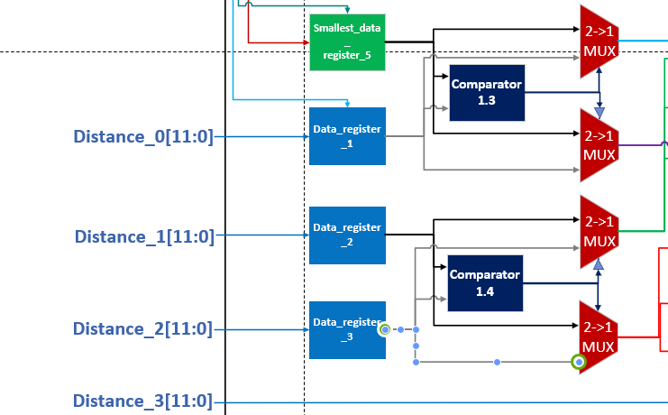
Bitonic Sort –PHASE 1

Slide 23
Bitonic Sort – phase 2
Phase 2

Slide 24
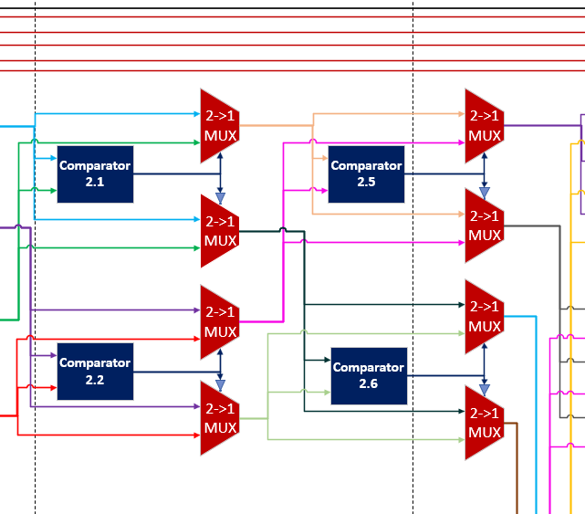
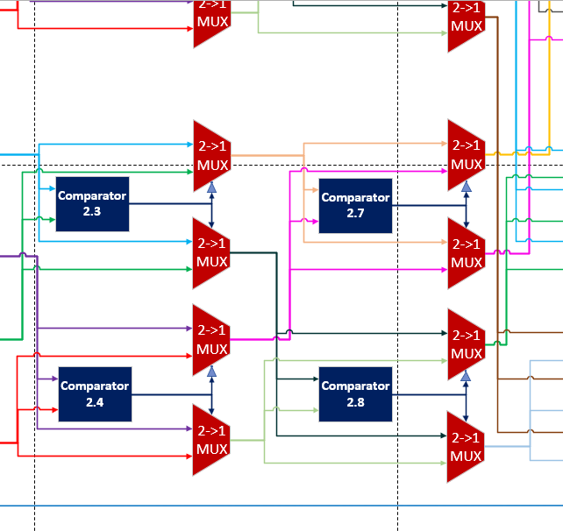
Bitonic Sort –PHASE 2

Slide 25
Bitonic Sort – phase 3
Phase 3

Slide 26
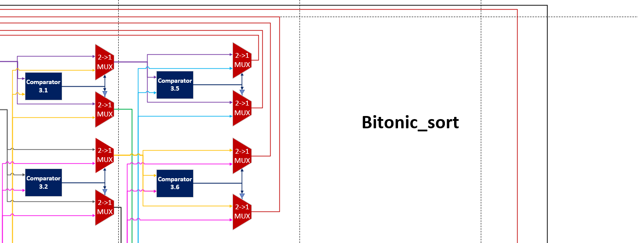
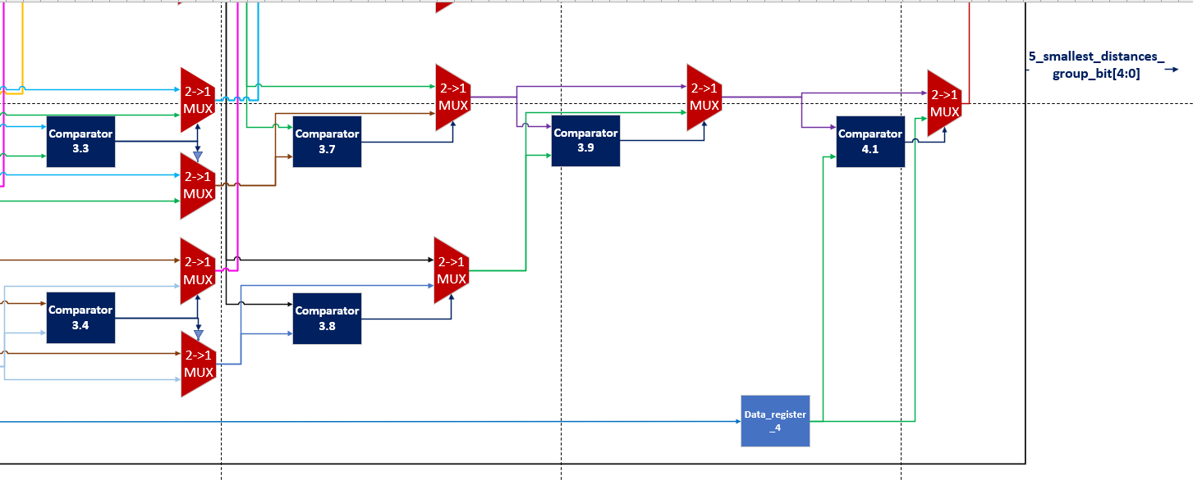

Slide 27
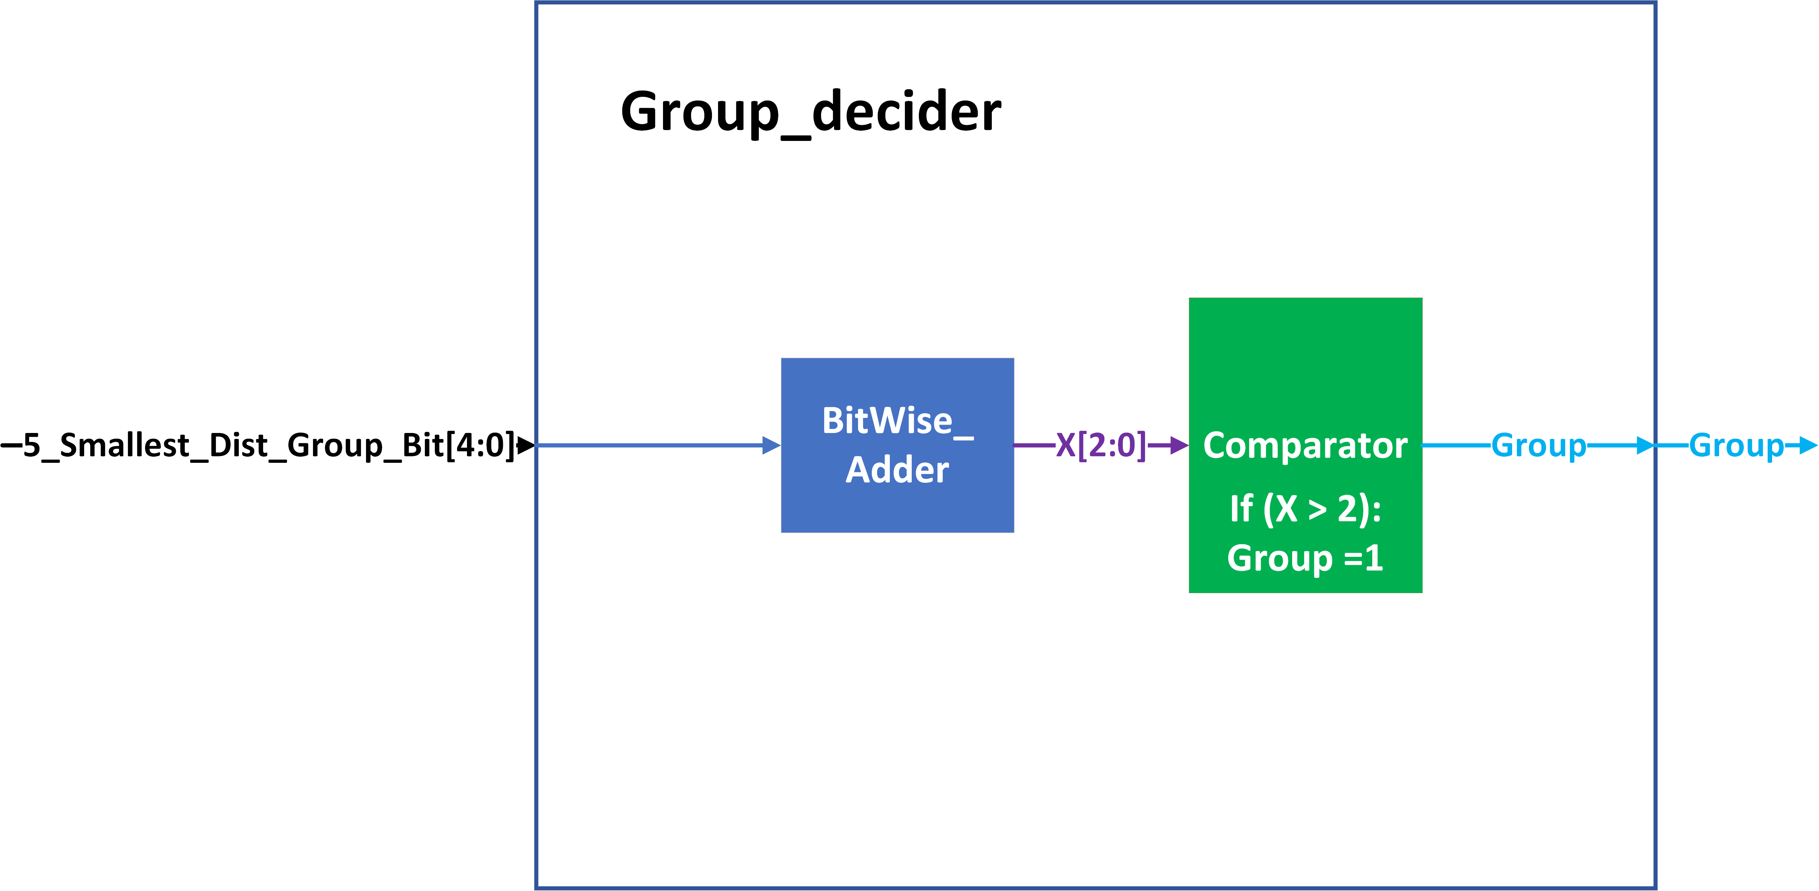
Group DECIDER

Slide 28
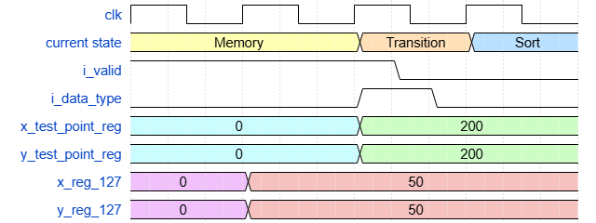
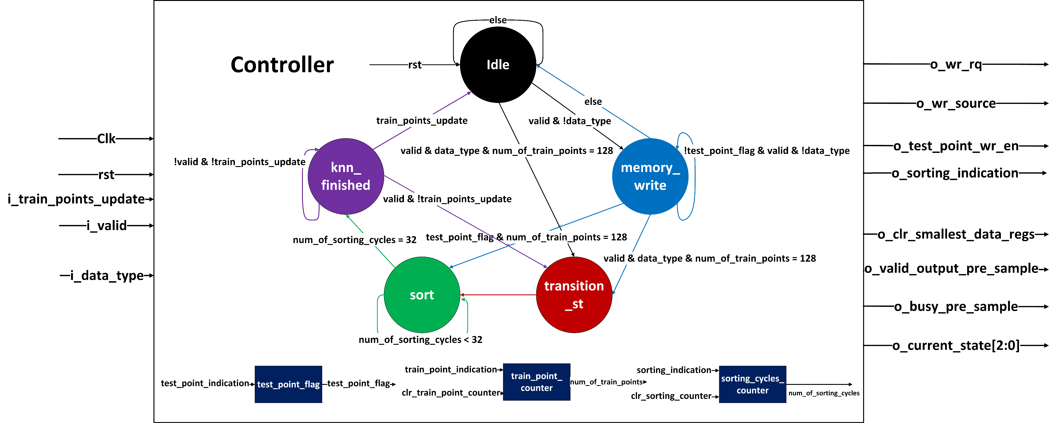

CONTROLLER
Euclidean distance: $\left|x_{1}−x_{2}\right|+|y_{1}−y_{2}|$

Slide 29
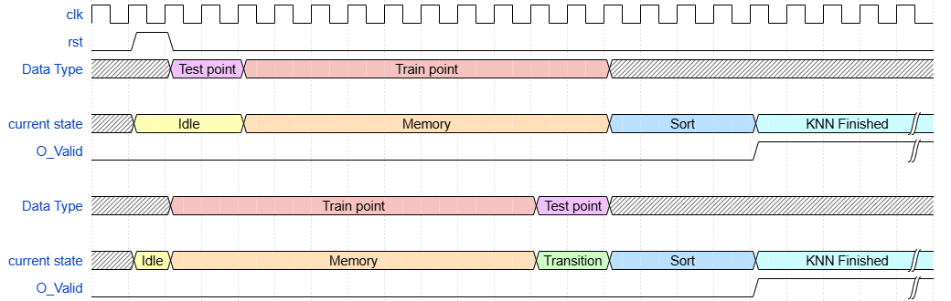
Waveform diagram
128 cycles
32 cycles
128 cycles
1 cycle
32 cycles

Slide 30
Critical path

Slide 31
Simulation tests
Memory:
  When wr_rq = 1 and wr_source = 0, ensure that 128 numbers can be written sequentially into the memory over 128 clock cycles.
  When wr_rq = 1 and wr_source = 0 ,verify cyclic writing within the memory , where the data from each register is written to the register with an index incremented by 4.
Distance calculator:
  Write to the test point register and ensure that unintended writes to the register do not occur during operation.
  Verify that the module perform addition and subtraction correctly for both positive and negative numbers.
Bitonic sort:
  Initalize the smallest data registers to their maximum possible values. than over 3 cycles, write 4 random numbers to the data_registers per cycle.
  Verify that, at the end of the process , the 5 smallest numbers are correctly stored in the smallest_data_registers.
Group Decider:
  Verify that for each possible 5-bit input value (ranging from 0 to 31), the module correctly determines the
  group classification.

Slide 32
Simulation tests
Top chip:
  Insert 128 training points, followed by 1 test point either immediately or after a defined interval.
  Insert a test point, followed by 128 training point either immediately or after a specified delay.
  Insert fewer than 128 training points, followed by a test point, and then remaining training points.
  Ensure that upon entering the knn_finished state, receiving a train or test point triggers the correct sequence execution.
  Insert over 128 training points
  Ensure train/test point insertion is ignored while in sort state.
  In the knn_finished state, on train_points_update, we switch to idle to allow another 128-training point.
  And if a test point is also received ,we write it to the test point regs.

Slide 33
Milestones Ahead
Synthesis (Include DFT)
Physical design
Tapeout (18.6.25)
Post-Silicon testing

Slide 34
THANK YOU!

